Slide 1
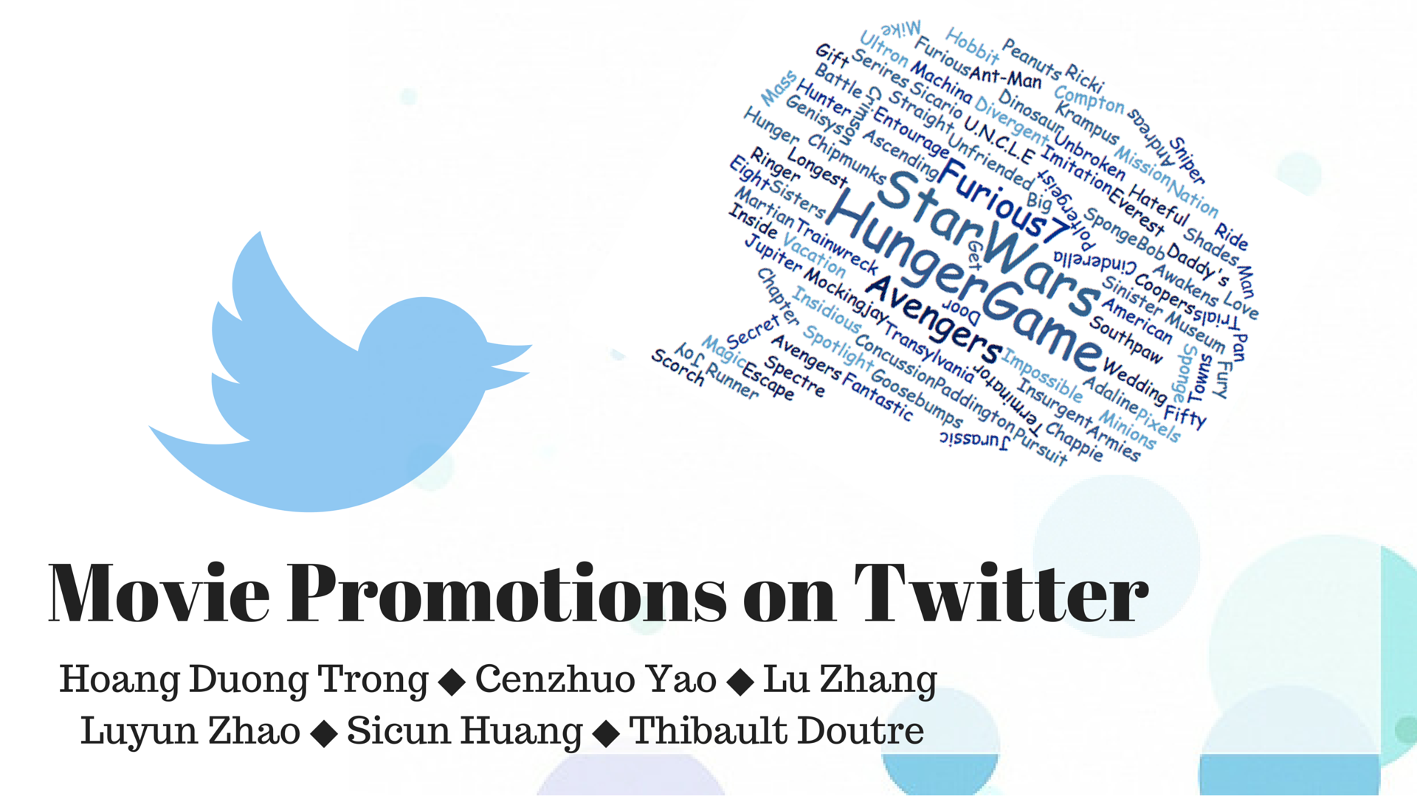
Notes:
For this Twitter project, our Team explored the promotion strategies used by the movie distributors on Twitter, and the public’s response towards those promotions. Particularly, we analyzed the top 100 grossing movies of 2015.

Slide 2
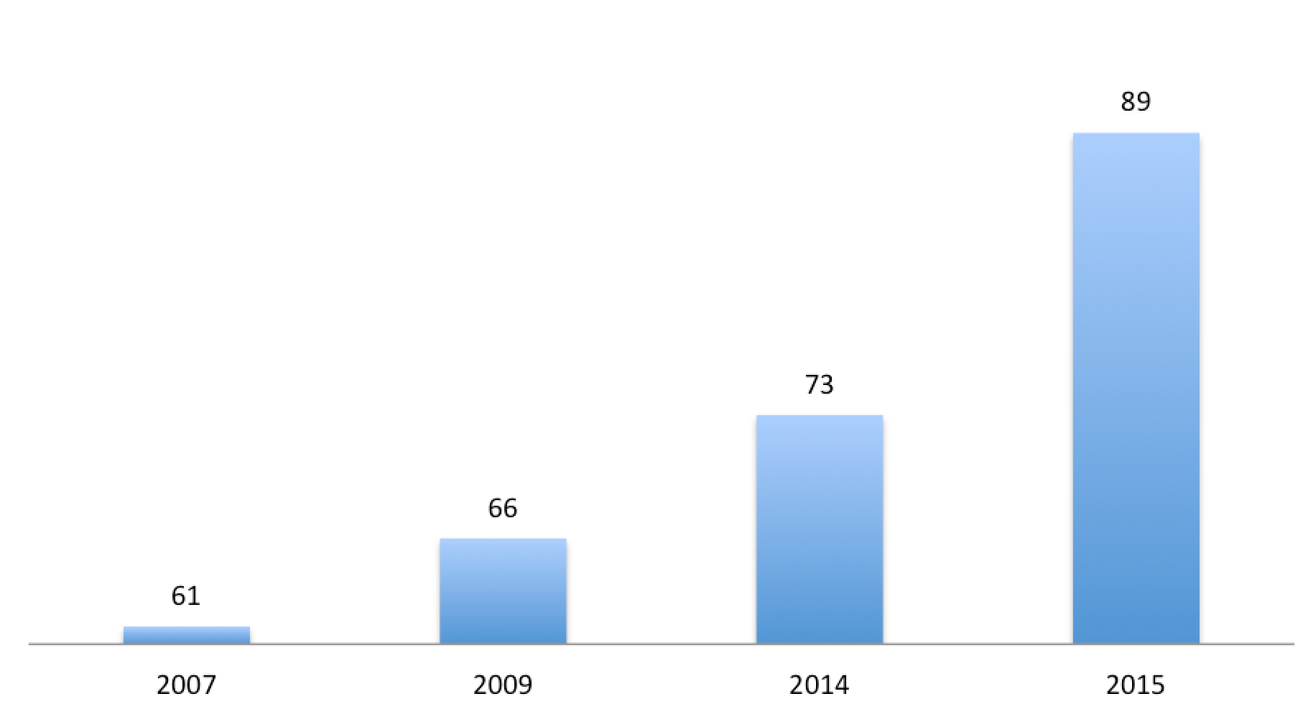
Number of Official Movie Twitter Accounts Over Time
No. of followers
11,591,814
No. of favorites
6,384,445
11M
6M
0.3M
8M
No. of tweets
291,527
No. of reweets
8,636,743
Notes:
First, we asked the question: Is Twitter a good platform to promote movies?
We found that number of official twitter accounts for the top-grossing movies is increasing. In year 2015, 89 out of 100 movies used a twitter account to promote their movie, which generates 0.3 M tweets, and 11M followers online.Therefore, we can see that Twitter provides access to a giant and continuously growing audience base, which makes movie promotions on twitter extremely important.

Slide 3
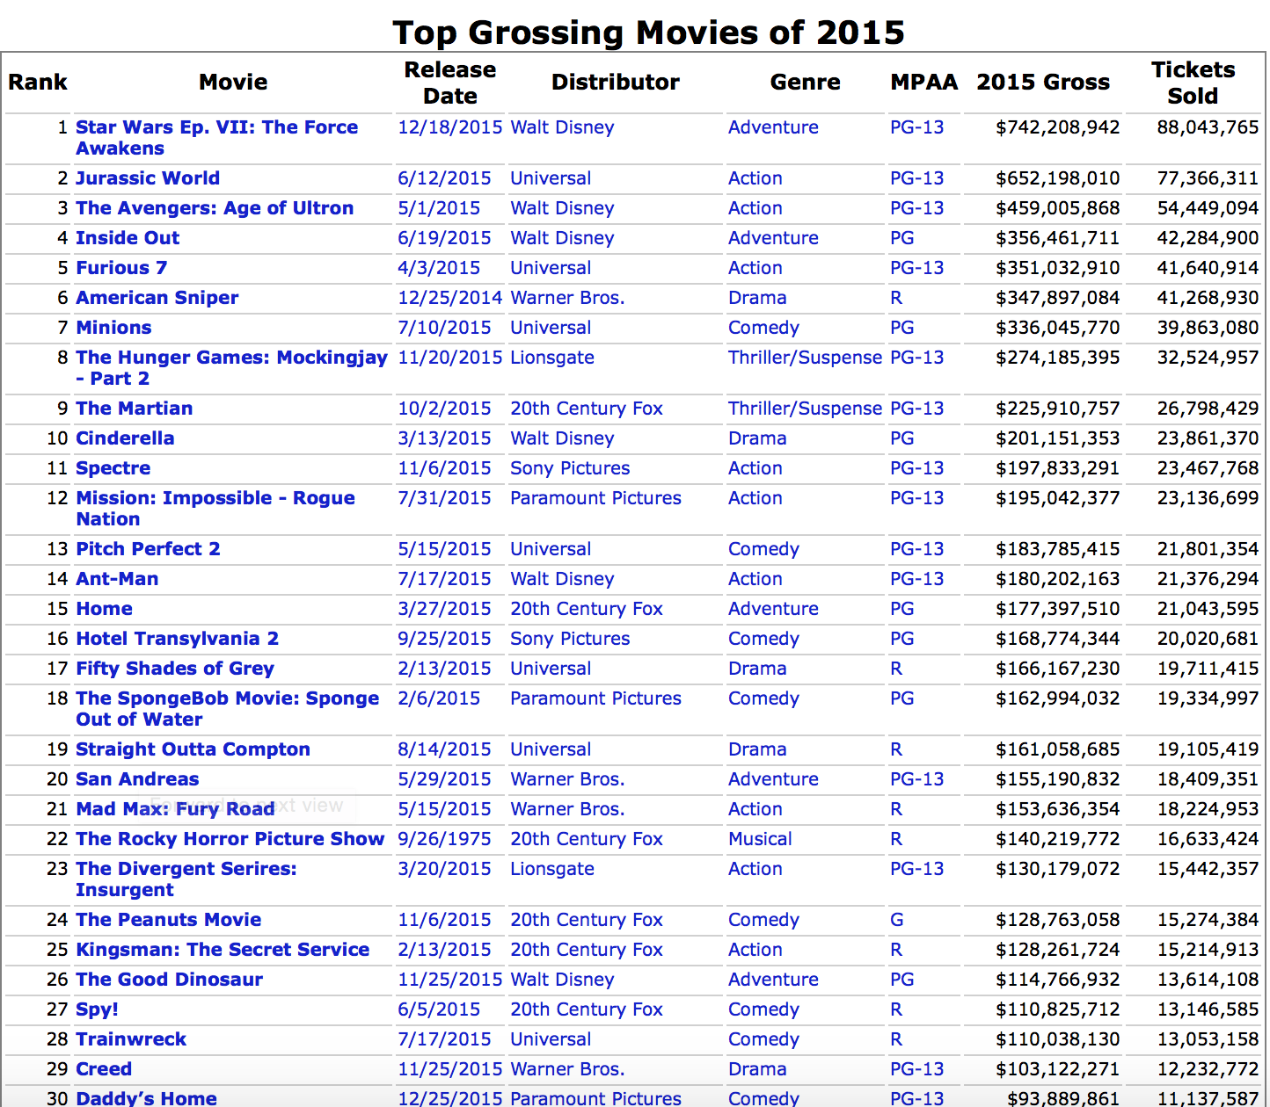

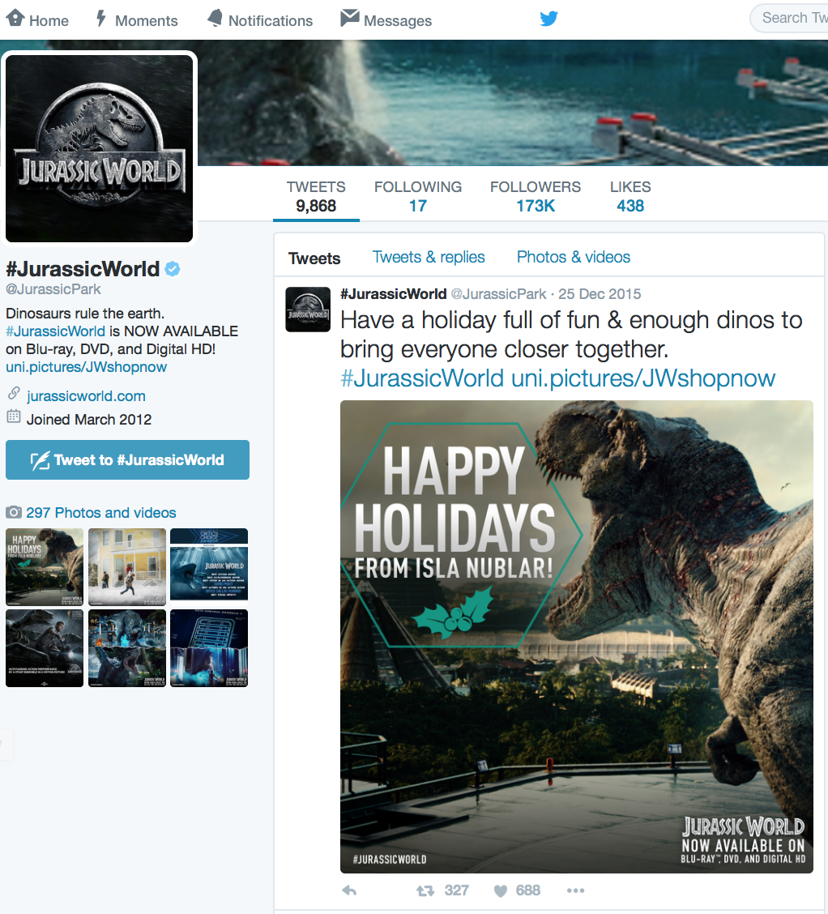
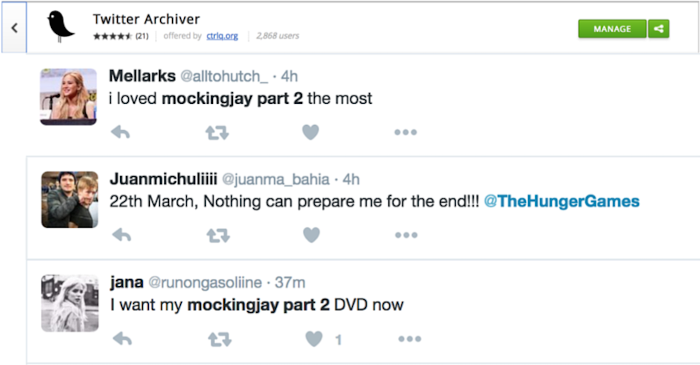
Data Sources
the-numbers.com
2015 top-grossing-movies
IMDB
Movie Ratings
Twitter Archiver
Search API
Twitter
REST API
Notes:
For this project, the data used in our analysis came from several different sources, mainly:
1.the numbers.com and IMDB (where we got the comprehensive information of the movies)
3.Through Twitter REST API app, we retrieved the 2 month interval timelines around the release date and the user info of the 89 official movie accounts;
4. We also obtained the public opinions through Twitter Archiver Search API

Slide 4
Questions
What are the most frequently used words? top 10 hashtags?
How are Twitter/IMDB account features related to Box office performance?
What are the different promotion styles?
Public opinions on these movies
Notes:
Under the big background of analyzing movie promotion, especially, those are the we are interested in:
my amazing teammates will talk more in depth on them.

Slide 5
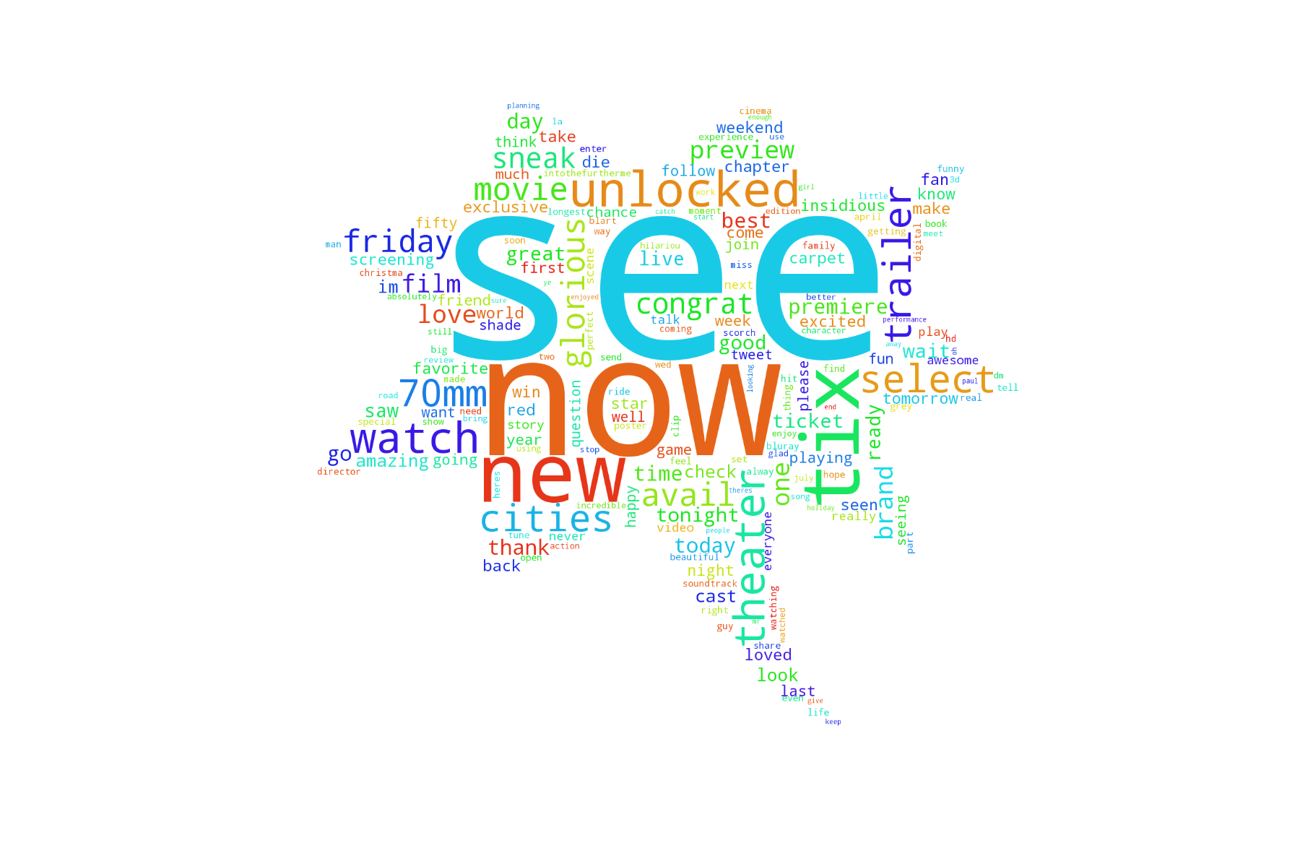
Word Cloud
Word | Frequency | Word | Frequency
see | 9150 | trailer | 3353
now | 8620 | select | 3248
new | 6852 | cities | 3145
tix | 6285 | glorious | 3118
unlocked | 5126 | avail | 3107
theaters | 4540 | friday | 3037
watch | 4195 | movie | 2700
Notes:
Generate word cloud after stripping out common stopwords.
Conclusion: typical words used in movie promotions; results were as expected

Slide 6
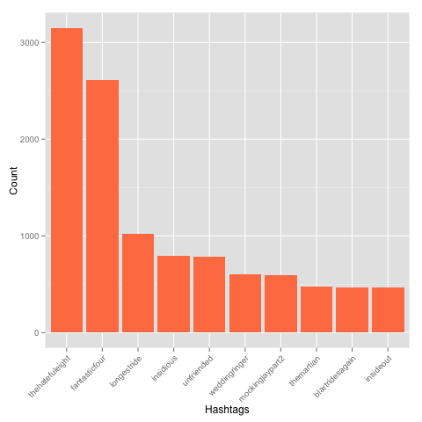
Frequently used hashtags, but…
Top 10 hashtags:
thehatefuleight
fantasticfour
longestride
insidious
unfriended
weddingringer
mockingjaypart2
themartian
blartridesagain
insideout
Notes:
observe that all hashtags are movie names.
used by official movie accounts

Slide 7
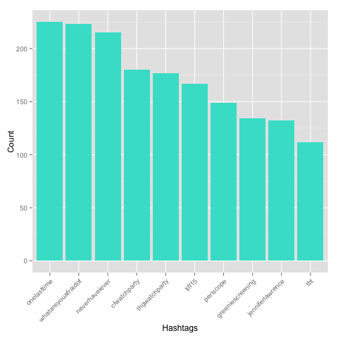
Frequently used hashtags (adjusted)
Top 10 hashtags (adjusted):
onelasttime
whatareyouafraidof
neverhaveiever
cfwatchparty
thgwatchparty
tiff15
periscope
greeniescreening
jenniferlawrence
tbt
Notes:
Heavily influenced by movie marketing campaigns:
6/10 hashtags were resulted from marketing campaigns
onelasttime--The Hobbit: The Battle of the Five Armies
whatareyouafraidof--Poltergeist
neverhaveiever--Unfriended, entourage
cfwatchparty--TheHungerGames
thgwatchparty--TheHungerGames
greeniescreening--Maze Runner: The Scorch Trials
tiff--Toronto International Film Festival
periscope
jenniferlawrence--JoyTheMovie', 'SistersMovie', 'TheHungerGames'
tbt

Slide 8
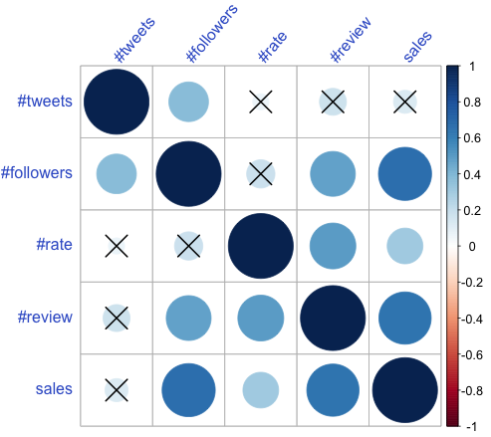
Correlogram
Significant Correlations:
number of followers vs. sales
number of reviews vs. sales
Notes:
Next, since we want to discover what features related to the box office performance, we draw this Correlogram and found out there are maybe some interesting relationship between the number of followers and the sales, also between the number of reviews and the sales.

Slide 9


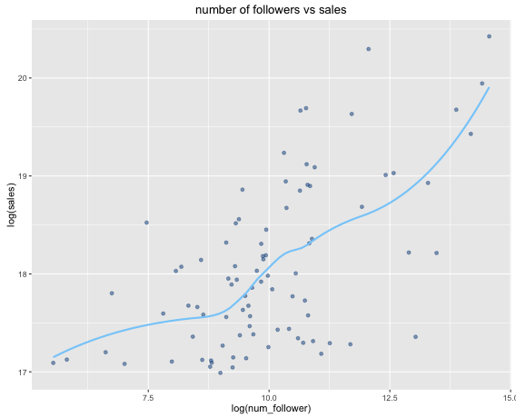
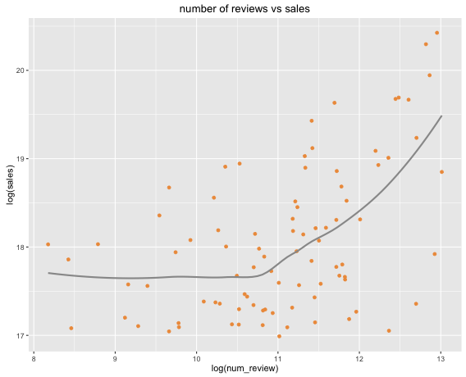
What twitter/IMDB account property reflects Sales/Rating?
Followers vs. Sales
Reviews vs. Sales
Notes:
So, we collect the data and draw out those two plots. You can see both the number of followers and the number of reviews are positively correlated to the sales, which means we can probably predicting a movie’s sale based on their number of followers on Twitter or the number of reviews they get from IMDB.

Slide 10
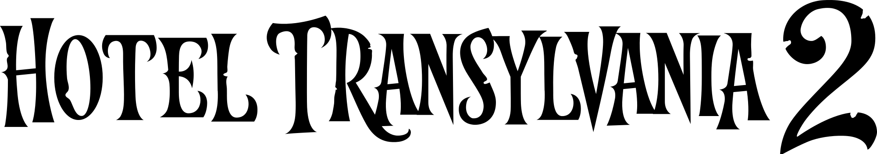



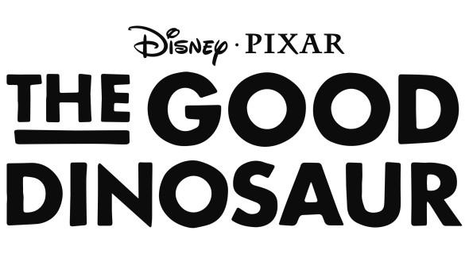
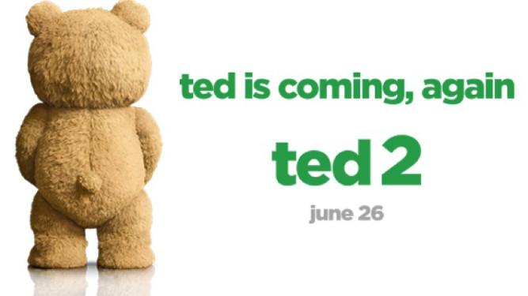
What twitter/IMDB account property reflects Sales/Rating?
Followers vs. Sales
Reviews vs. Sales
Notes:
However, we observe some unusual points. For example, Ted2 has lots of followers on Twitter but its sale is really low, maybe that’s because people have high expectation on this movie based on the performance of Ted1, however it turned out to be a bad movie. Also, on this plots, those four movies are all cartons where the majority audience are children, therefore, it makes sense that they don’t get so many reviews while have a good performance on sales.

Slide 11
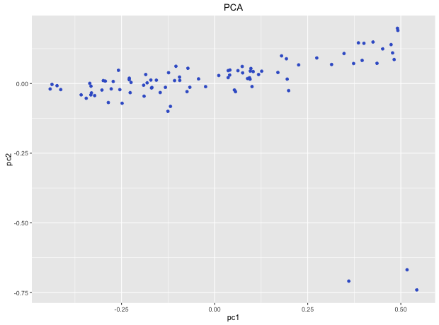
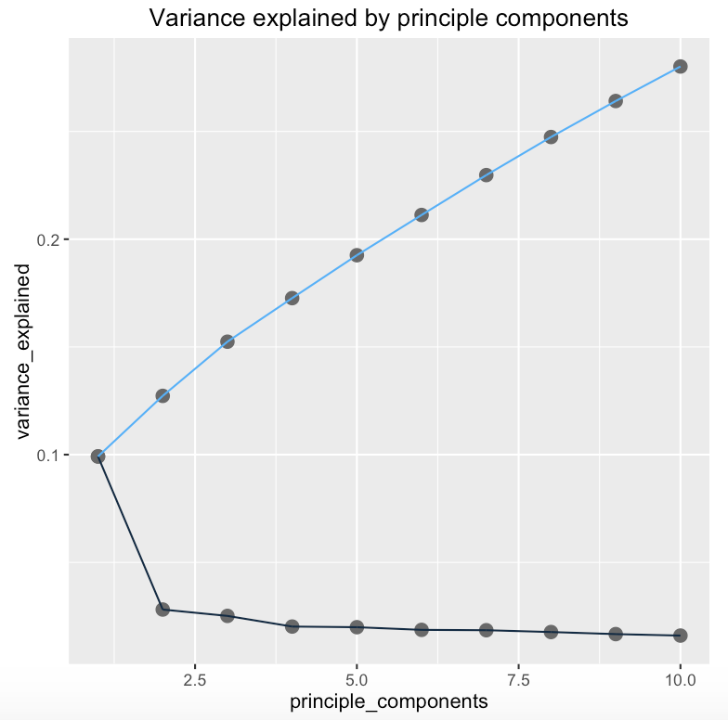
Principle Component Analysis & Data Visualization
Notes:
To visualize the data, we use PCA to reduce the dimension. Here is the plot for the first two PCs. There are 3 outliers on the bottom right. However, we don’t know the actual distance, as it is only the projection of 2 PC. So intuitively, we’ll try to use k-means to detect other anomalies.

Slide 12
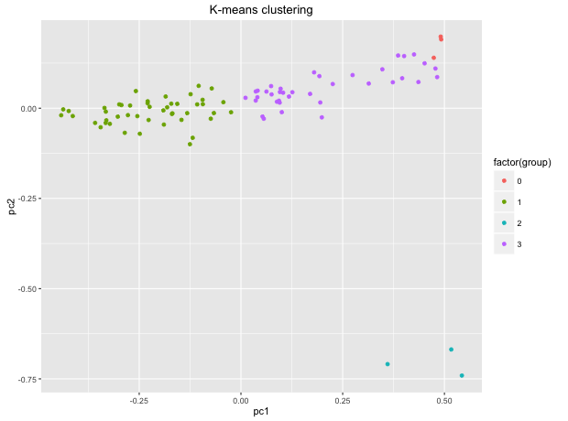
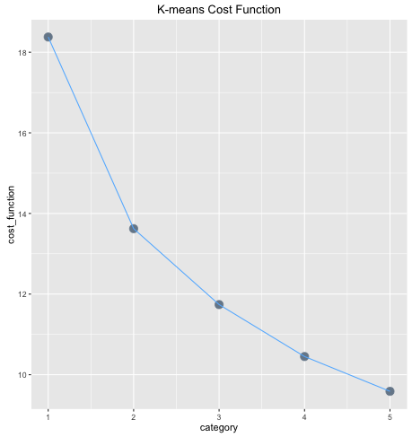
K-Means Classification Algorithm & Anomaly Detection
Notes:
By the cost function, we choose k=4 and here is our outcome. Most movies are in green or purple, but there are red and blue that seems to be outliers. Blue is not very surprising but the red seems interesting. But if you see later PCs, there are close to each other but far from others.

Slide 13

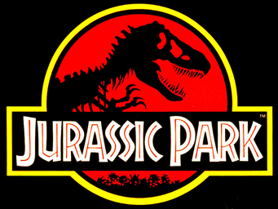

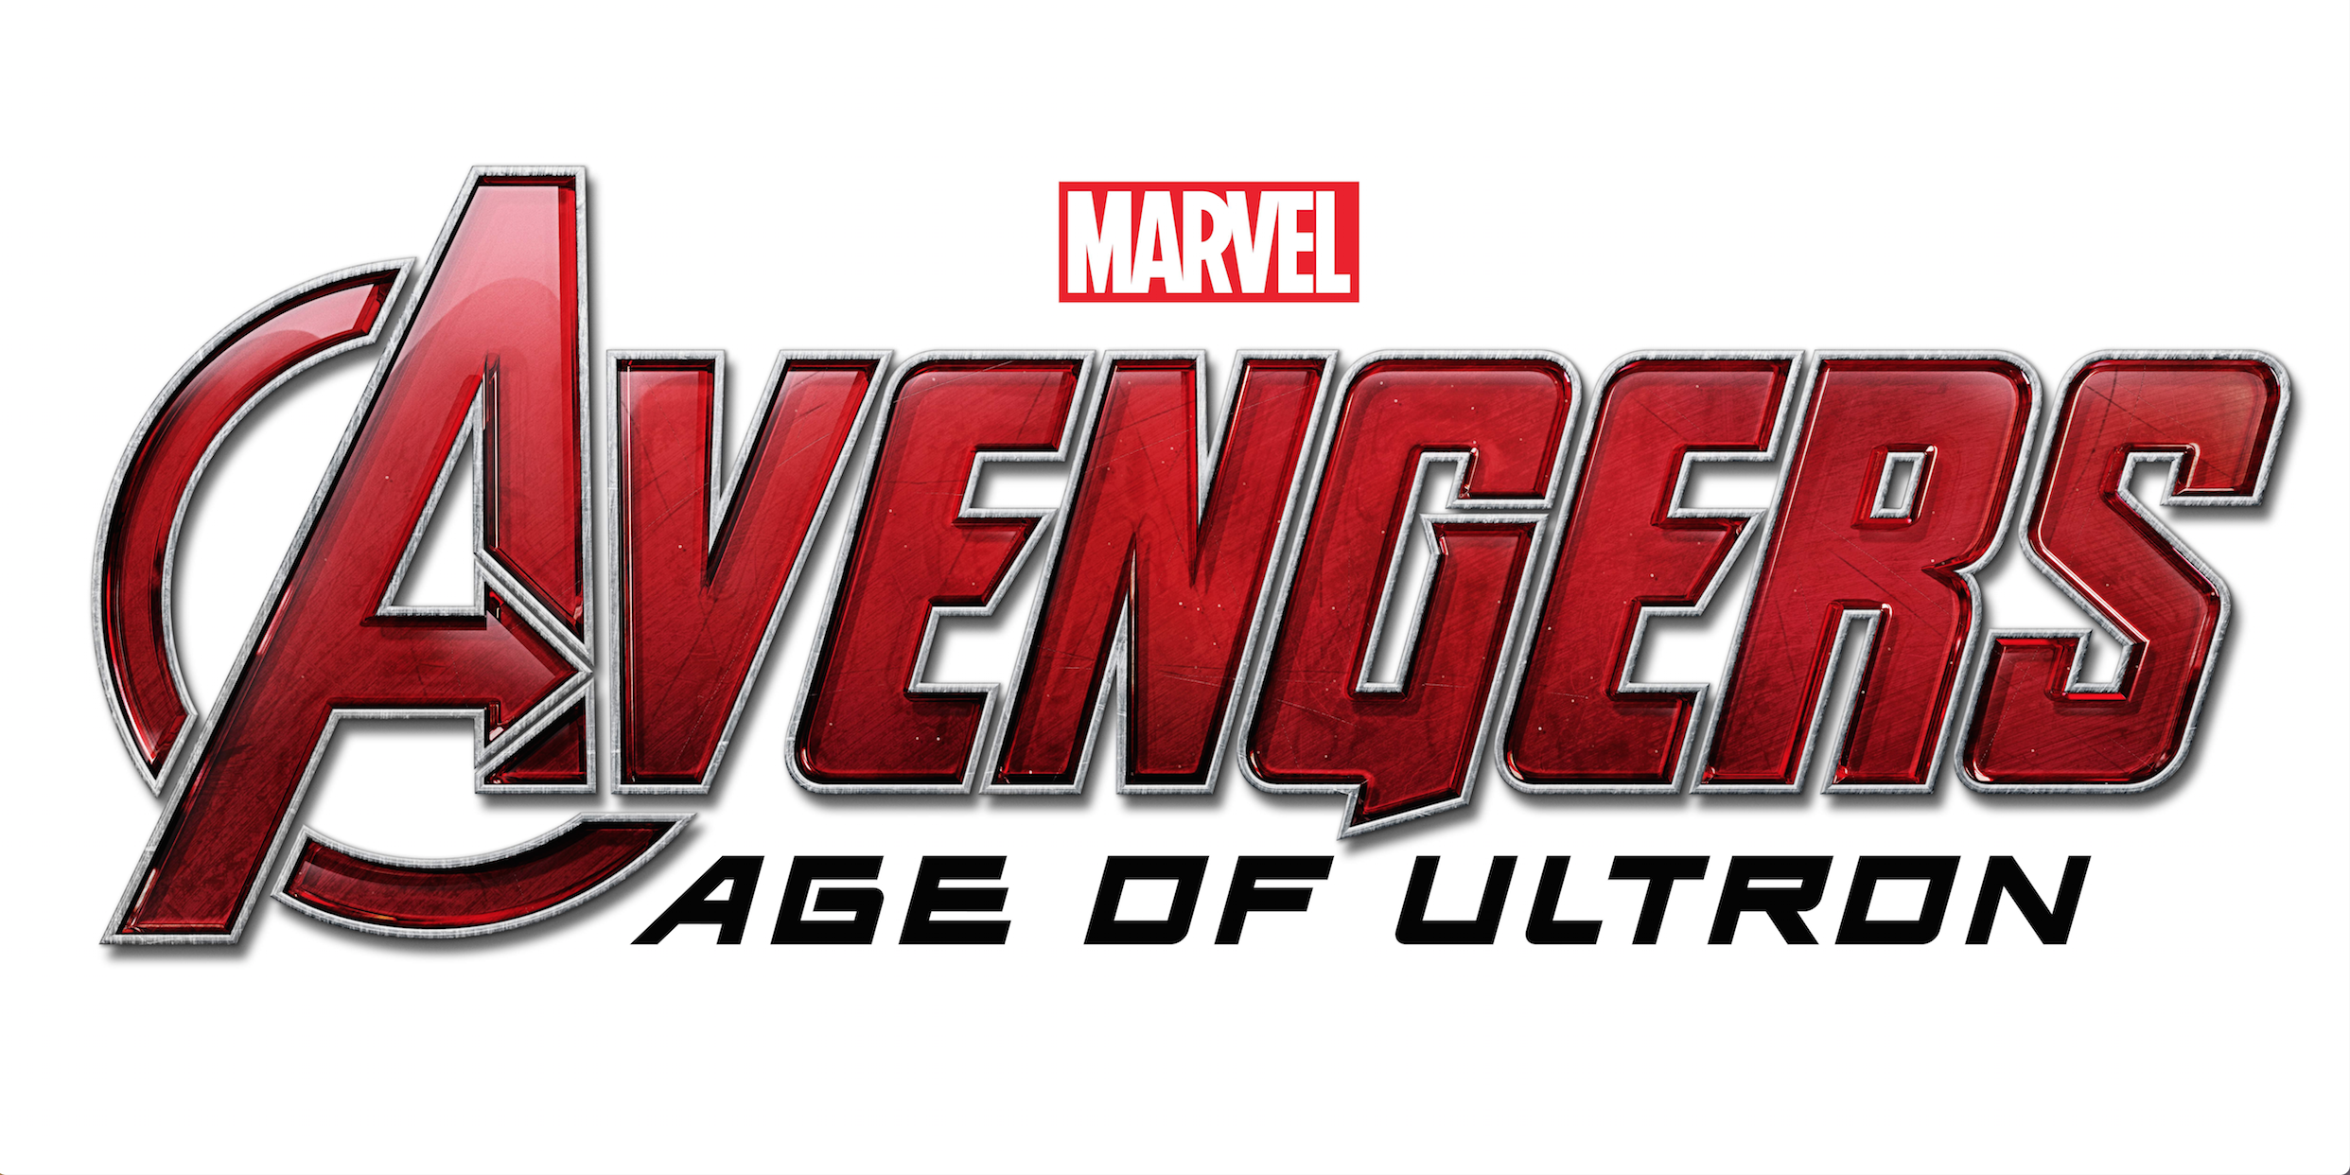


K-Means & Anomaly Detection(Cont’d)
Notes:
So let’s take a closer look about our red and blue group. For each of the group, we choose one movie to see how they tweet.

Slide 14
What resulted in outliers?
@TashaPuffs Now you can get #PitchPerfect2! RT if you’re ready for more music 🎶 & extended scenes.
@_littlelena Now you can get #PitchPerfect2! Retweet if you’re ready for more music 🎶& extended scenes.
@DanyelleWadswo1 Now you can get #PitchPerfect2! Retweet if you’re ready for more music 🎶& extended scenes.
@sofiesdad08 Now you can get #PitchPerfect2! RT if you’re ready for more music 🎶 & extended scenes.
@OfficiallyMoye Now you can get #PitchPerfect2! RT if you’re ready for more music 🎶 & extended scenes.
@SapphireZebra It’s unlocked! Watch the new @Avengers trailer & get tix now.
@allanc234 It’s unlocked! Watch the new @Avengers trailer & get tix now.
@RhysMillham It’s unlocked! Watch the new @Avengers trailer & get tix now.
@Kebabycakes It’s unlocked! Watch the new @Avengers trailer & get tix now.
@loolz_7 It’s unlocked! Watch the new @Avengers trailer & get tix now.
Notes:
Here are 5 sample from their tweets. For others, they do not spam, and their promotion style are quite similar.

Slide 15
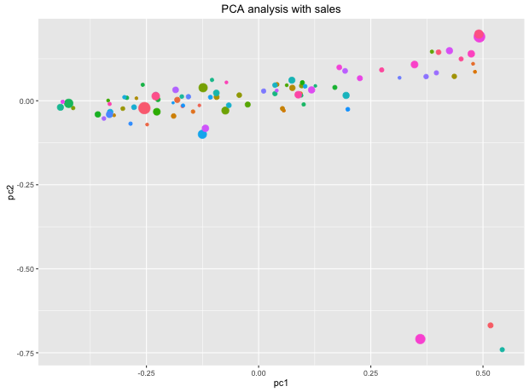
PCA with Sales

Slide 16
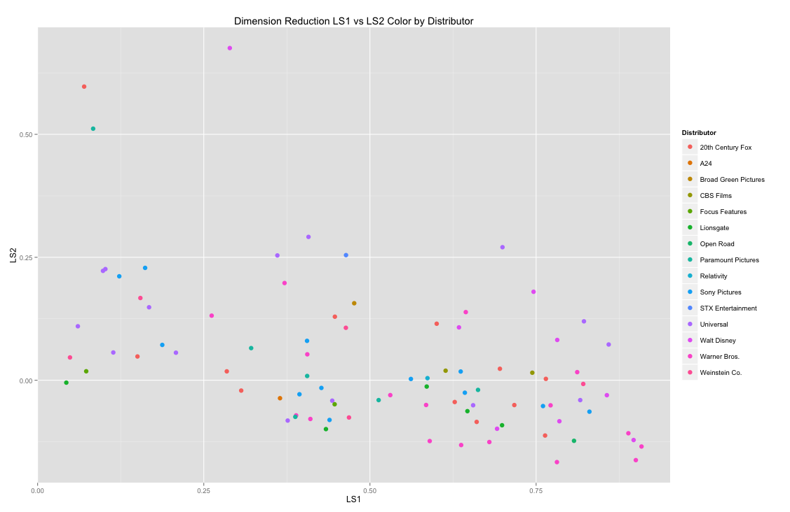
Latent Semantic Analysis with Distributors

Slide 17
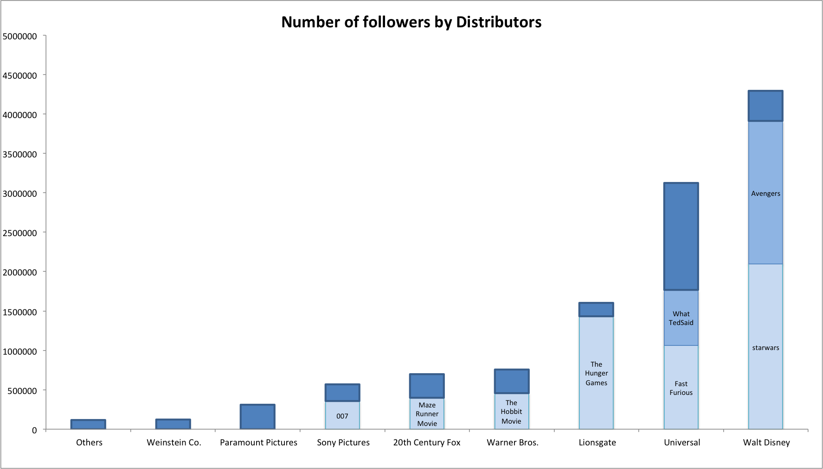
Number of followers by Distributors
8
15
5
12
17
12
5
6
8

Slide 18
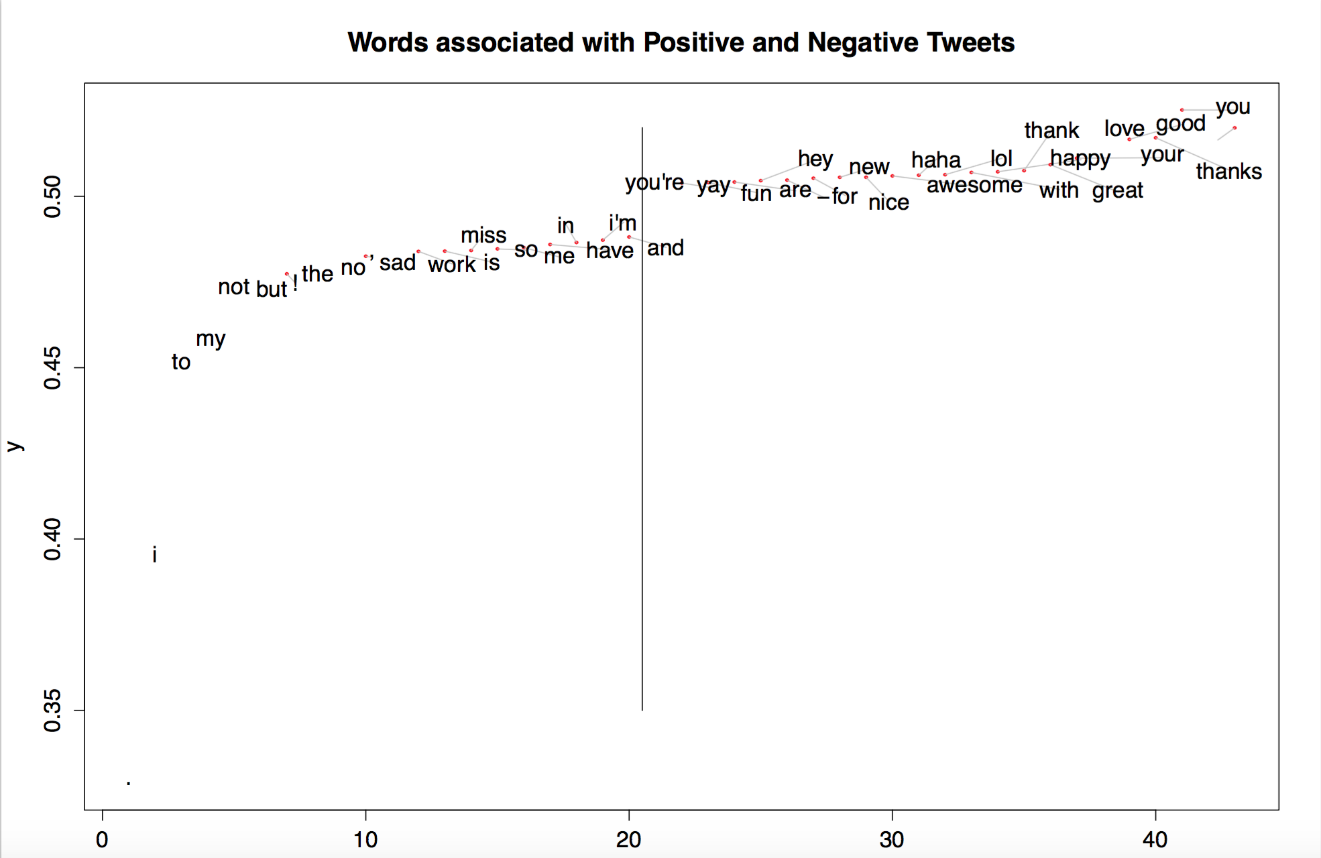
Words associated with Positive and Negative Tweets

Slide 19
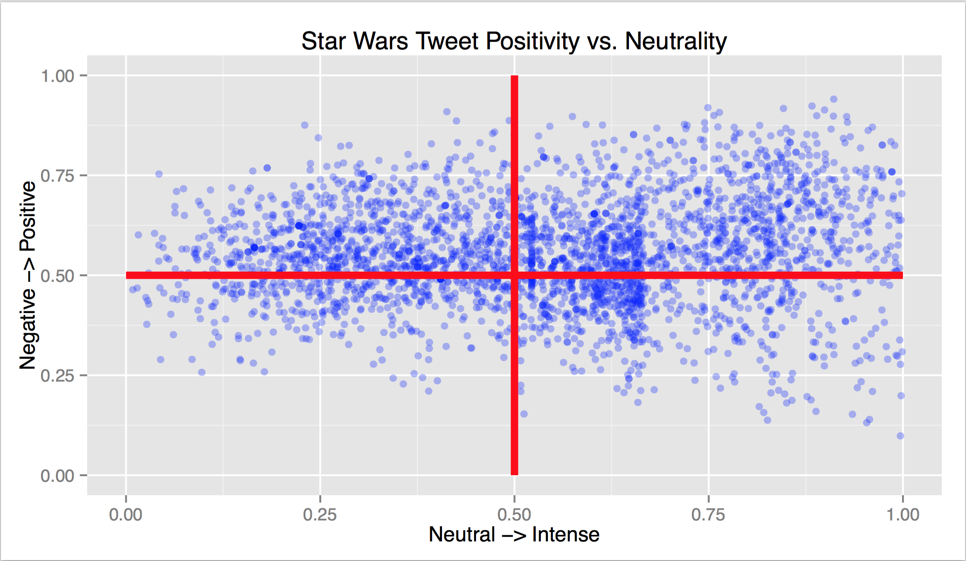
Sentiment Analysis for the new StarWars

Slide 20
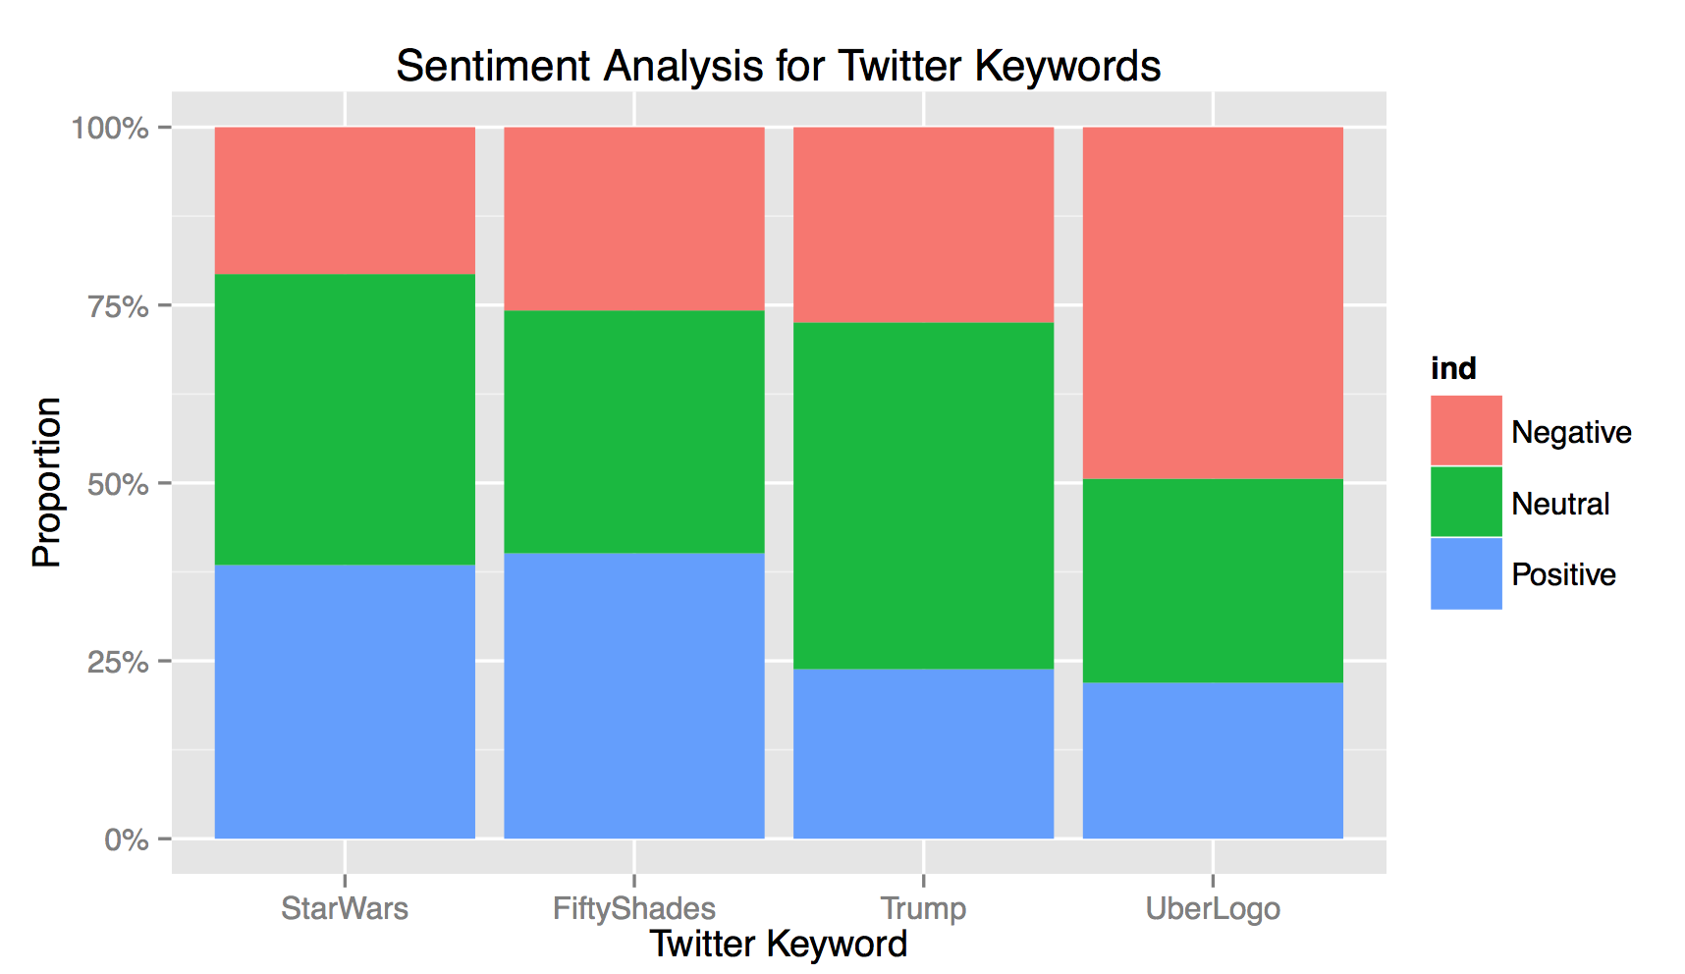
Sentiment Analysis of Twitter Keywords

